Slide 1
Green University of Bangladesh
Department of Computer Science & Engineering
Subject: Computer Computer Architecture Course Code: CSE-211
Presentation topic : Huffman Encoding Technique
Submitted To:
Name : Syed Ahsanul Kabir
Designation : Asst.Professor
Department : CSE
Green university of Bangladesh
Submitted by:
Name : Nazifa Alam Nowrin
ID :193002103
Section :DB (193)
Department : CSE

Slide 2
Content :
What is Huffman Encoding Technique?
Why do we use Huffman Encoding Technique?
Basic steps of Huffman Encoding Technique
Example
Applications

Slide 3
What is Huffman Encoding Technique?
Lossless data compression
Fixed length codes into variable length codes
Most frequent characters having smallest codes
Least frequent characters having longer codes

Slide 4
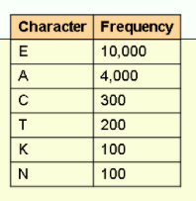
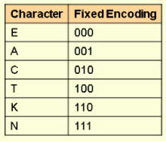
Why do we use Huffman Encoding Technique?
For an example :
No compression :
each character = 1 byte (8 bits)
total file size = 14,700*8=117,600 bits
2. Fixed sized compression :
we have 6 characters, so we need 3bits to encode them
Total file size = 14,700*3=44,100bits

Slide 5
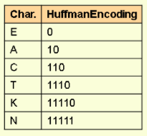
3.Huffman compression :
variable length compression
assigning shorter codes to more frequent characters and longer codes to less frequent characters
Total file size = ( 10,000*1)+(4,000*2)+(300*3)+(200*4)+(100*5)+(100*5)= 20,700 bits

Slide 6
Basic steps of Huffman Encoding Technique
Preparing the frequency table.
constructing the binary tree and Assigning the codes
Extracting the Huffman codes
Encoding

Slide 7
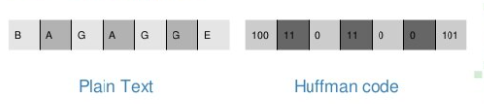
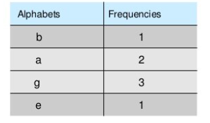
Example
Step 1 : Creating frequency table

Slide 8
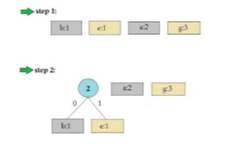
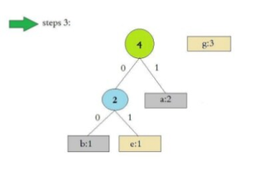
Example
Step 2 : Constructing binary tree

Slide 9
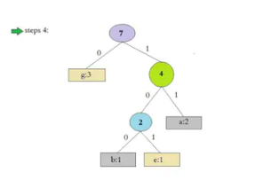
Example
Huffman tree

Slide 10
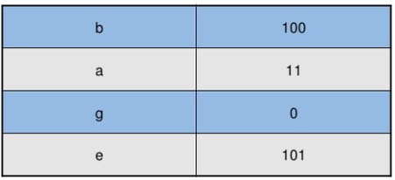
Example
Step 3 : extracting Huffman codes
Step 4 : Encoding
Instruction : bag
derived opcode = 100 11 0

Slide 11
Applications
Text compression
Image data
Mp3 files
Fax machine
computer security

Slide 12
Arithmetic Circuit
Working of Arithmetic circuit.
Thank You

Slide 13
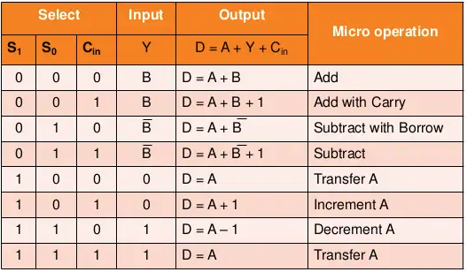
Arithmetic circuit
Arithmetic circuit table:4.5

Slide 14
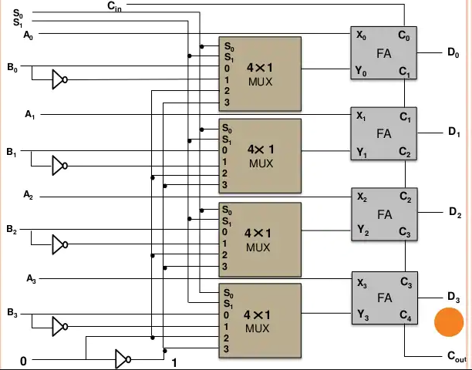
Arithmetic circuit Working
Addition:
If Cin = 0, the output D = A + B.
If Cin =1, output D = A + B + 1.
Subtraction:
If Cin = 1, then D = A +Bʹ+ 1.
When Cin = 0, then D = A + Bʹ
Increment:
D = A + 0 + Cin
D = A when Cin = 0
D = A + 1 when Cin = 1.
Decrement:
D = A – 1 when Cin = 0
Cin = 1, then D = A – 1 + 1 = A
Figure:4.9

